Slide 1
Preprocessing, Feature Selection, and Cross-Validation
Key Ingredients for a Winning Solution in Kaggle’s DecMeg2014 Competition
-Nathan Hammes, 10/9/14

Slide 2
DecMeg2014 Data
Magnetoencephalography data
23 subjects (16 train, 7 test)
306 sensors (204 gradiometers, 102 magnetometers)
600 trials/subject
1.5s/trial at 250Hz
Even split of face/scrambled face trials
Each subject is 3D array of 600 trials x 306 sensors x 375 timepoints,

Slide 3
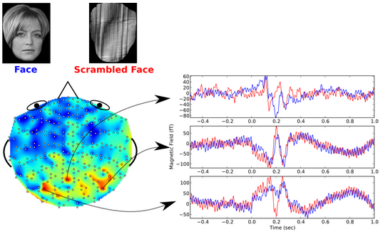
DecMeg2014 Data

Slide 4
Evaluation
“The evaluation metric for this competition is prediction accuracy, i.e. the total number of correct predictions over the total size of the test set.
Notice that the (public) score on the leaderboard and the final (private) score of the competition are computed on trials from different sets of subjects. For this reason it could happen that the public score on the leaderboard may be substantially different [emphasis mine] from the final score.”
Public Leaderboard Private Leaderboard
Private leaderboard prevents overfitting, and is the final ranking.

Slide 5
Timeline
Monday, April 21, 2014 - Competition begins
Sunday, July 20, 2014 - Deadline to make first submission
Sunday, July 27, 2014 - Final submission deadline

Slide 6
Prizes
1st place - $3000
2nd place - $1500
3rd place - $500

Slide 7
Overview of Steps
Step 1: Gather domain knowledge.
Step 2: Use domain knowledge to preprocess the data, also known as feature engineering.
Step 3: Pick a classifier or an ensemble of classifiers.
Step 4: Choose parameters for the classifiers through cross-validation.
Step 5: Train a classifier on all training data.
Step 6: Predict test data labels using the classifier.
Step 7: Submit predictions.

Slide 8
Theory
Reality (1st phase)
Step 1: Gather domain knowledge.
Step 2: Use domain knowledge to preprocess the data, also known as feature engineering.
Step 3: Pick a classifier or an ensemble of classifiers.
Step 4: Choose parameters for the classifiers through cross-validation.
Step 5: Train a classifier on all training data.
Step 6: Predict test data labels using the classifier.
Step 7: Submit predictions.
Step 3: Pick a classifier or an ensemble of classifiers.
Step 5: Train a classifier on all training data.
Step 6: Predict test data labels using the classifier.
Step 7: Submit predictions.
Step 8: Repeat.

Slide 9
Theory
Reality (2nd phase)
Step 1: Gather domain knowledge.
Step 2: Use domain knowledge to preprocess the data, also known as feature engineering.
Step 3: Pick a classifier or an ensemble of classifiers.
Step 4: Choose parameters for the classifiers through cross-validation.
Step 5: Train a classifier on all training data.
Step 6: Predict test data labels using the classifier.
Step 7: Submit predictions.
Step 1.5: Use your own knowledge to preprocess the data, also known as guessing.
Step 3: Pick a classifier or an ensemble of classifiers.
Step 5: Train a classifier on all training data.
Step 6: Predict test data labels using the classifier.
Step 7: Submit predictions.
Step 8: Repeat.

Slide 10
Theory
Reality (3rd phase)
Step 1: Gather domain knowledge.
Step 2: Use domain knowledge to preprocess the data, also known as feature engineering.
Step 3: Pick a classifier or an ensemble of classifiers.
Step 4: Choose parameters for the classifiers through cross-validation.
Step 5: Train a classifier on all training data.
Step 6: Predict test data labels using the classifier.
Step 7: Submit predictions.
Step 1, Step 3, Step 2, Step 4, Step 2, Step 4, Step 2, Step 4.
Step 3 (pick a different classifier), Step 2, Step 4, Step 2, Step 4, Step 2, Step 4.
Step 3 (pick a another classifier), Step 2, Step 4, Step 2, Step 4, Step 2, Step 4, Step 5, Step 6, and finally Step 7.
Circle back to steps where improvement is possible.

Slide 11
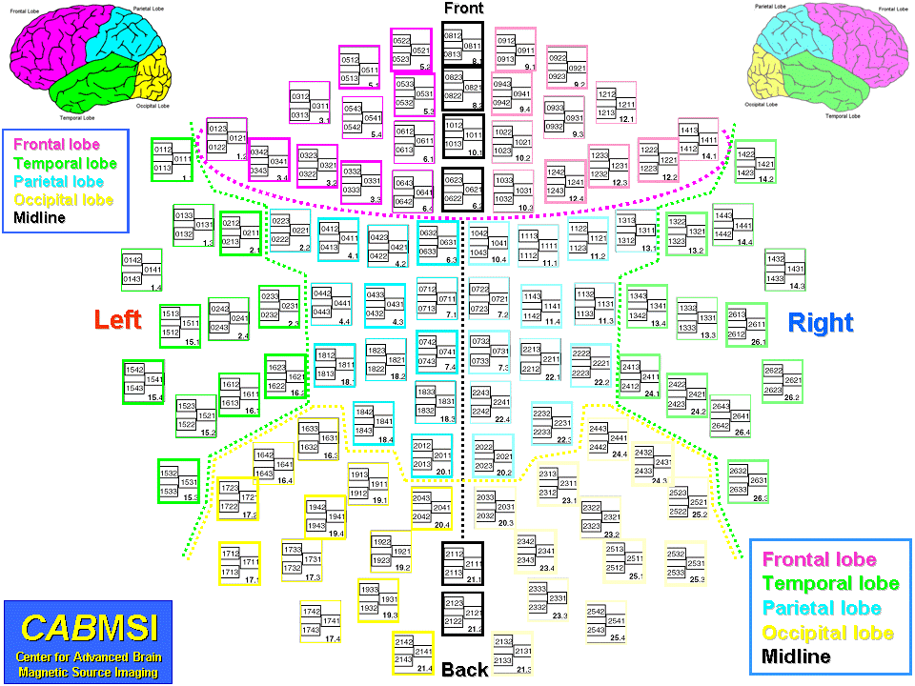
Step 1: Domain Knowledge

Slide 12
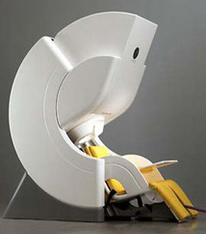
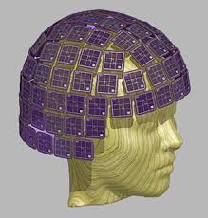
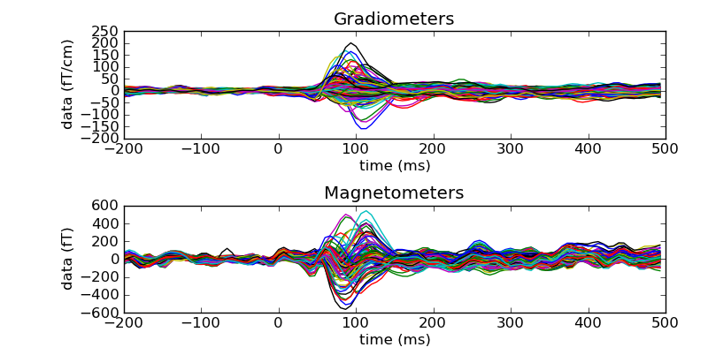
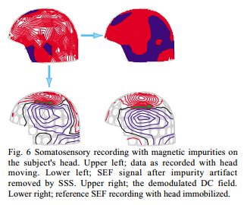
Step 1: Domain Knowledge
http://www.mrn.org/collaborate/elekta-neuromag/
The Signal Space Separation Method Taulu 2004

Slide 13
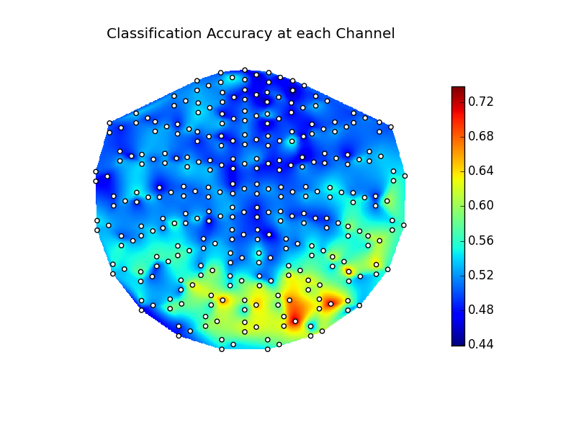
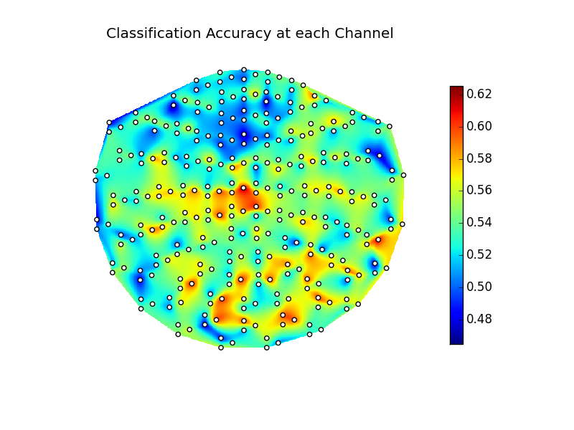
Step 1: Transfer Learning
Performing transductive transfer learning using a feature-representation transfer approach (temporary ppt switch)
The 23 subjects indeed have different responses to the same stimuli - Subjects 16 and 12 classification accuracy below

Slide 14
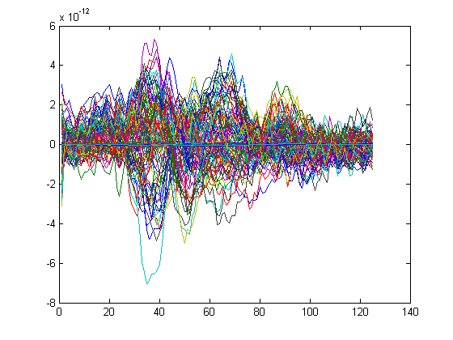
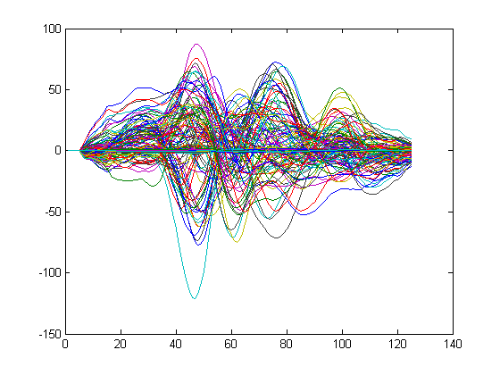
Step 2: Preprocessing
Plenty of information given to at least low-pass filter the data at 100Hz, and use a notch filter to cut the 50Hz power-line noise

Slide 15
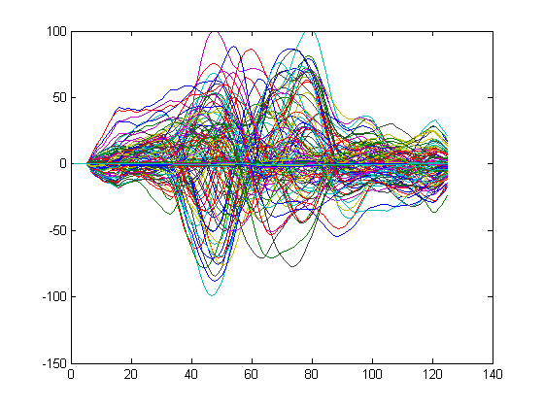
Step 2: Preprocessing
Scrambled Face Means
Face Means
Subject 1

Slide 16
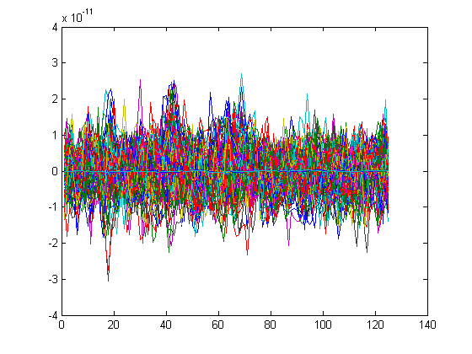
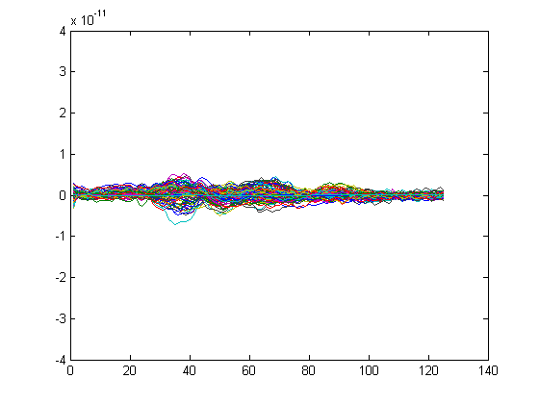
Step 2: Preprocessing
Trial 1
Face Means (at trial scale)
Subject 1

Slide 17
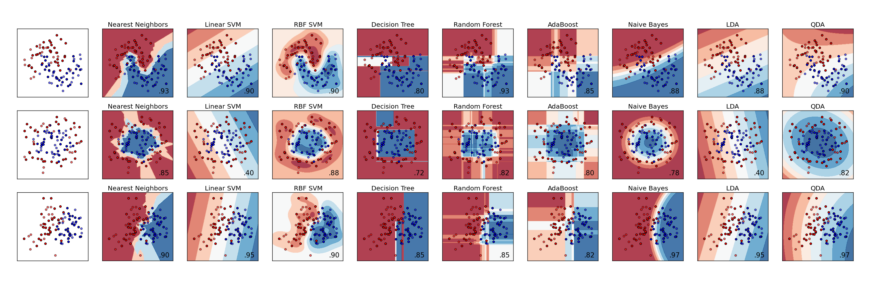
Step 3: Classifier Selection
Tens of classifiers to choose from
Various implementations of the more popular classifiers
Below: Example of classification results in 3 different scenarios with 9 of scikit-learn’s classifiers (Python)

Slide 18
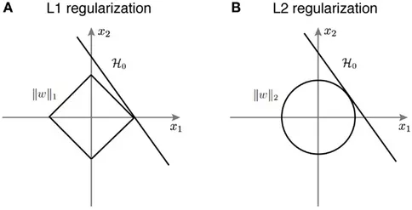
Step 3: Lasso/Elastic Net
Benchmark classifier for the competition, a type of logistic regression.
Parameter α determines degree of L1 regularization.
α=.9 was the benchmark code’s choice, and was the best when CVed
Public Leaderboard

Slide 19
Step 4: Cross-validation
Initial weeks: Single-subject decoding
Split subject 1’s trials 6-fold, train a lasso classifier on 5 folds, predict the remaining folds. Repeat for the 5 other stratifications, and then for the other 16 training subjects.
Save decoding accuracies, and choose the best preprocessing that works best for each subject.
Best decoding accuracy with a lasso classifier and well preprocessed data: 82%
About 3 seconds/classifier, 3s x 6classifiers x 16subjects is about 5 minutes per run

Slide 20
Step 4: Cross-validation
1st-place competitor’s post: here
“One major problem with MEG/EEG data is that the signal is extremely weak and noisy. A large part of this noise comes from the brain itself and therefore has the same statistical distribution as the signal of interest. So it is very difficult to extract something relevant from these data. Another problem is that the strength of the Evoked potentials we are looking for is modulated by the user attention and mental fatigue. My opinion is that even with an infinite amount of training data, we can not achieve a perfect classification, some trials can simply not be classified correctly because the user was not paying enough attention or because the evoked potential is so small that it can not be extracted from the noise.
…
Regarding the scores, my best in the LB is 0.772, and this method get 0.746 in leave-one-out CV (and something around 0.87 in 6-fold CV in a single-subject decoding manner).”

Slide 21
Step 4: Cross-validation
Decided I needed a new classifier
Tried a support vector machine, and with adjustment, was able to achieve 87% 6-fold single-subject accuracy
Adjustment in this case means trial-and-error…

Slide 22
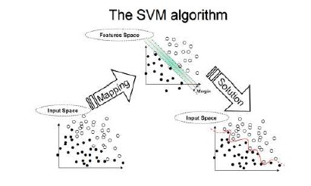
(Back to) Step 3: Standard SVM
Finds the classifier that creates the maximum-margin hyperplane between the points given the parameters
Using a hyperplane in higher dimensions results in complex boundaries in input space
http://www.dtreg.com/svm.htm

Slide 23
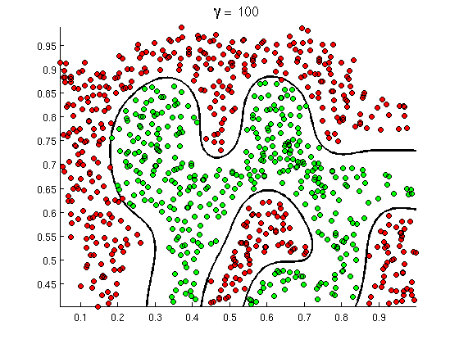
Step 3: Standard SVM
Using a hyperplane in higher dimensions, combined with different “kernel” mappings, results in complex boundaries in input space
Resultant classifiers are defined by “support vectors”, a set of input samples that lie along the boundary
RBF kernel →
http://openclassroom.stanford.edu/MainFolder/DocumentPage.php?course=MachineLearning&doc=exercises/ex8/ex8.html

Slide 24
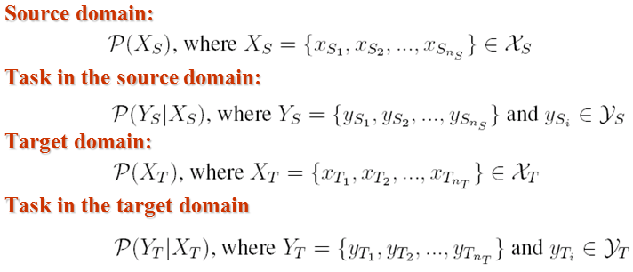
Step 3: Transductive SVM
Implementation found online by Thorsten Joachims at Cornell University
Iteratively increases influence of the unlabeled data as the SVM progresses, a kind of transfer learning
http://svmlight.joachims.org/
MATLAB wrapper: http://sourceforge.net/projects/mex-svm/

Slide 25
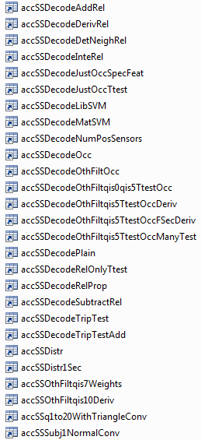
Step 4: Cross-validation

Slide 26
Step 4: Leave-one-out CV
Takes much longer – classifier is working with 15x the data
Could take 15 classifiers and combine them to predict one subject, or 1 classifier trained on 15 subjects
Single classifier was better.
A single lasso classifier took 10 minutes
Standard SVM also about 10 minutes
Transductive SVM took 2.5 hours
So, with just lasso or just SVM, a single LOO CV run would take nearly 3 hours.
Transductive SVM took 40 hours of computational time (performed twice, once with, once without magnetometers).

Slide 27
Step 4: Classifier Comparison
Lasso | Regular SVM | Trans SVM | Mean
.7609 | .7071 | .7643 | .7441
.6553 | .7048 | .6894 | .6832
.6159 | .6194 | .6228 | .6194
.7845 | .7374 | .8013 | .7744
.6689 | .6962 | .6758 | .6803
.6735 | .5918 | .6599 | .6417
.7041 | .7228 | .7177 | .7149
.6486 | .7213 | .6791 | .6830
.7677 | .7357 | .7643 | .7559
.6780 | .7085 | .6814 | .6893
.7196 | .6841 | .7297 | .7111
.7201 | .6553 | .7406 | .7053
.6633 | .7092 | .6939 | .6888
.6633 | .6990 | .7007 | .6876
.7103 | .6810 | .7000 | .6971
.5831 | .5458 | .5864 | .5718
.6886 | .6825 | .7005 | .6905

Slide 28
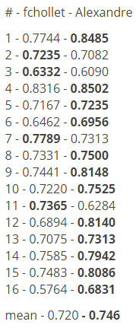
Nathan
.7441
.6832
.6194
.7744
.6803
.6417
.7149
.6830
.7559
.6893
.7111
.7053
.6888
.6876
.6971
.5718
.6905
1st-place competitor’s post: here
“Anyway, i agree with you, the level of 0.76 will be very hard to overcome, but if you consider that the best model is the model you can extract from the data of the subject itself, the theoretical limit is much higher.”
I.e. Alexandre was using some kind unsupervised algorithm based on each subject’s data alone.

Slide 29
Step ?: More ideas
Anyone can use a classifier – they’re well-tested algorithms, and (for the most part) freely available
Best solutions are found from among the more human-centric steps of feature engineering and post-classifier analysis
A good solution in this case is known to be some form of unsupervised learning. Unsupervised learning is basically machine learning without any guidance. A pattern is deduced from the data without the assistance of labels.
Public Leaderboard Private Leaderboard

Slide 30
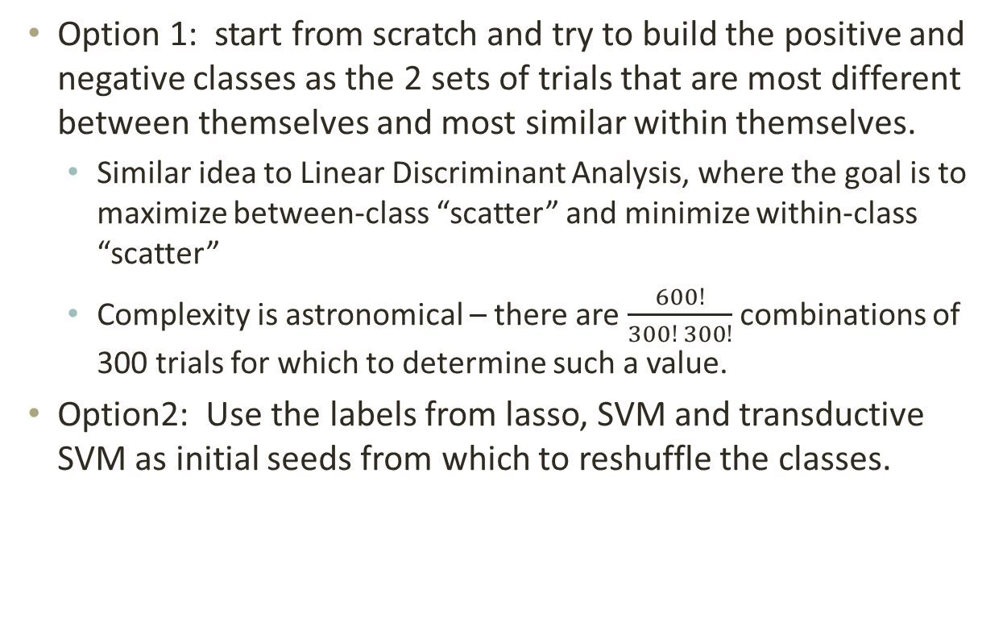
Step ?: More ideas
Option 1: start from scratch and try to build the positive and negative classes as the 2 sets of trials that are most different between themselves and most similar within themselves.
Similar idea to Linear Discriminant Analysis, where the goal is to maximize between-class “scatter” and minimize within-class “scatter”
Complexity is astronomical – there are $\frac{600!}{300! 300!}$ combinations of 300 trials for which to determine such a value.
Option2: Use the labels from lasso, SVM and transductive SVM as initial seeds from which to reshuffle the classes.

Slide 31
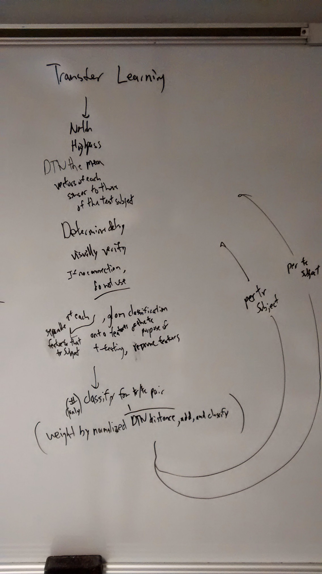
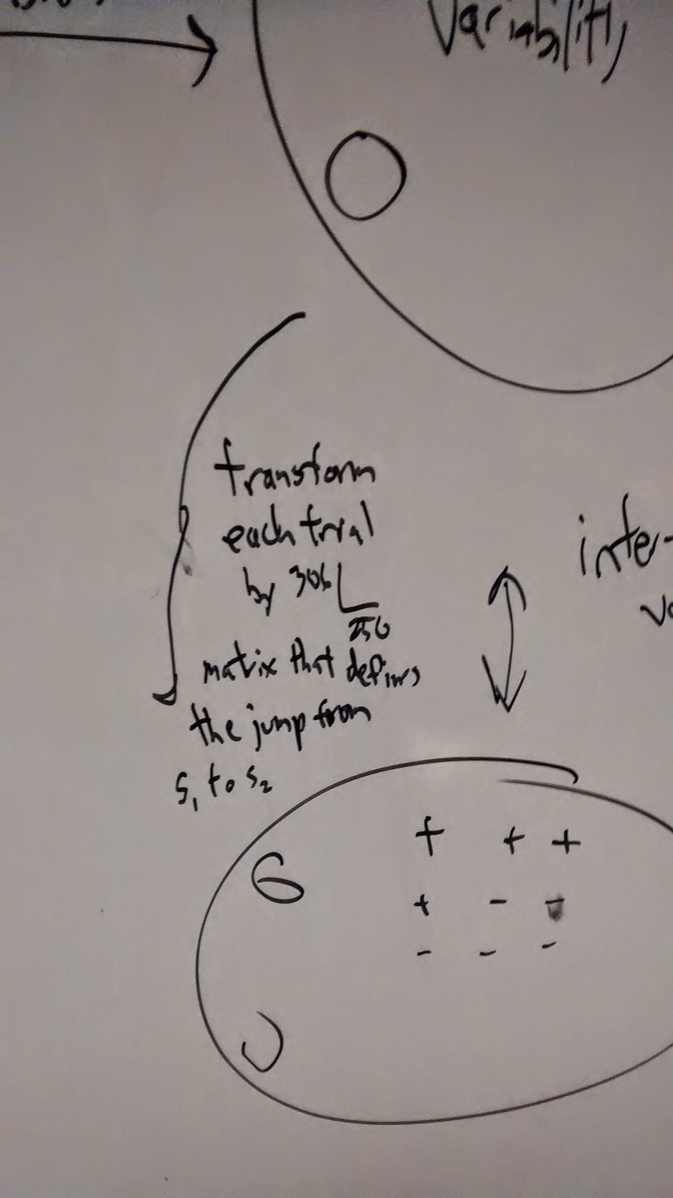

Slide 32
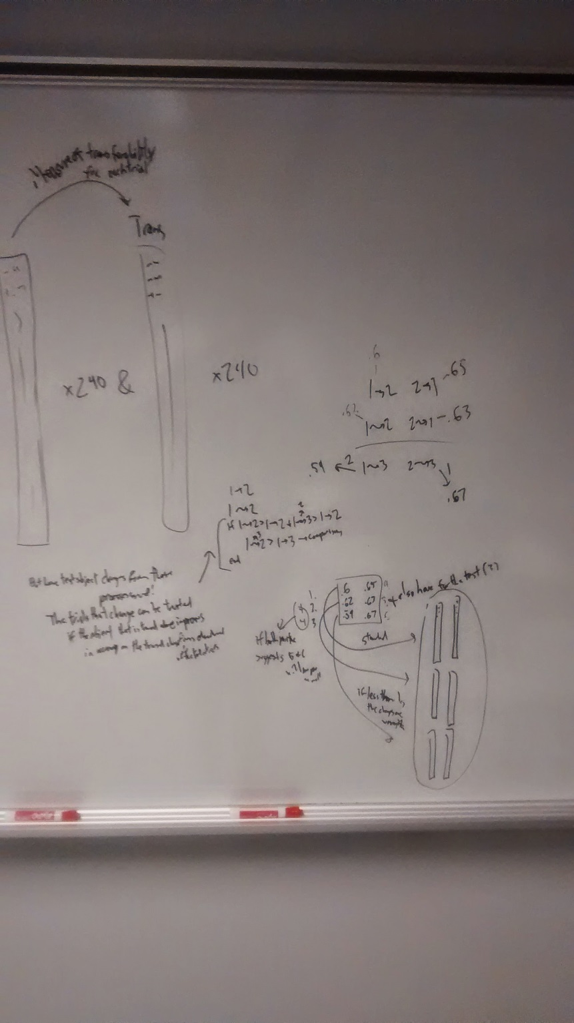

Slide 33
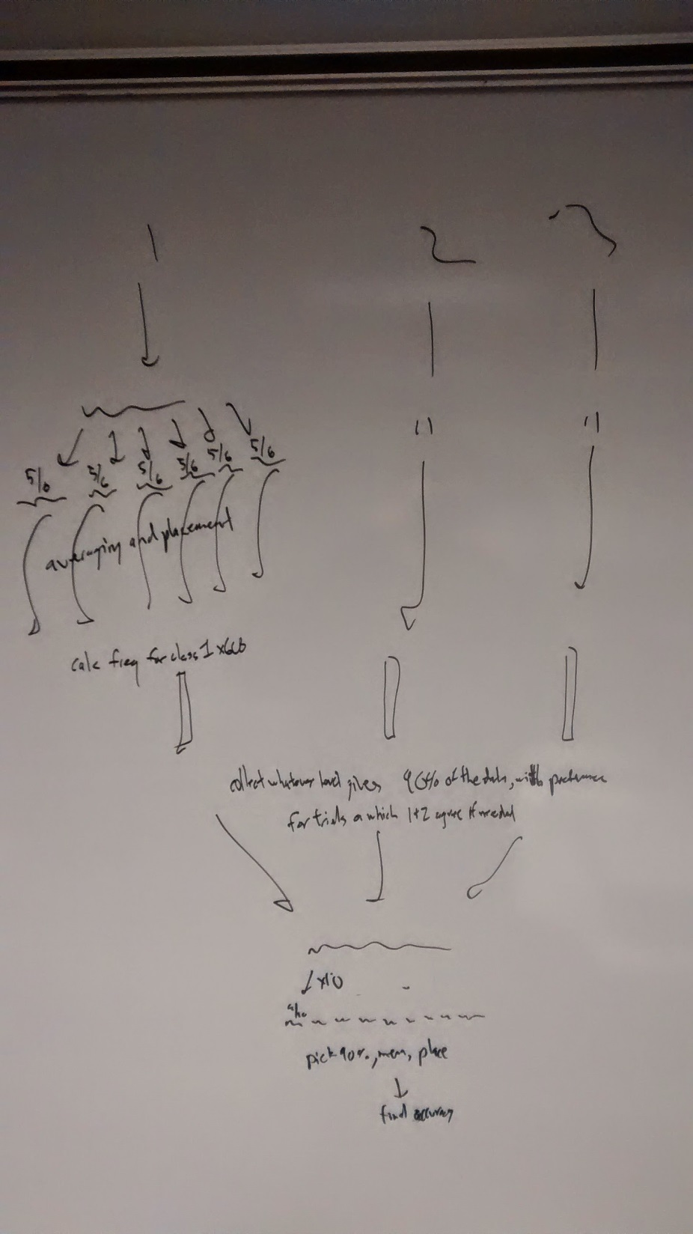

Slide 34
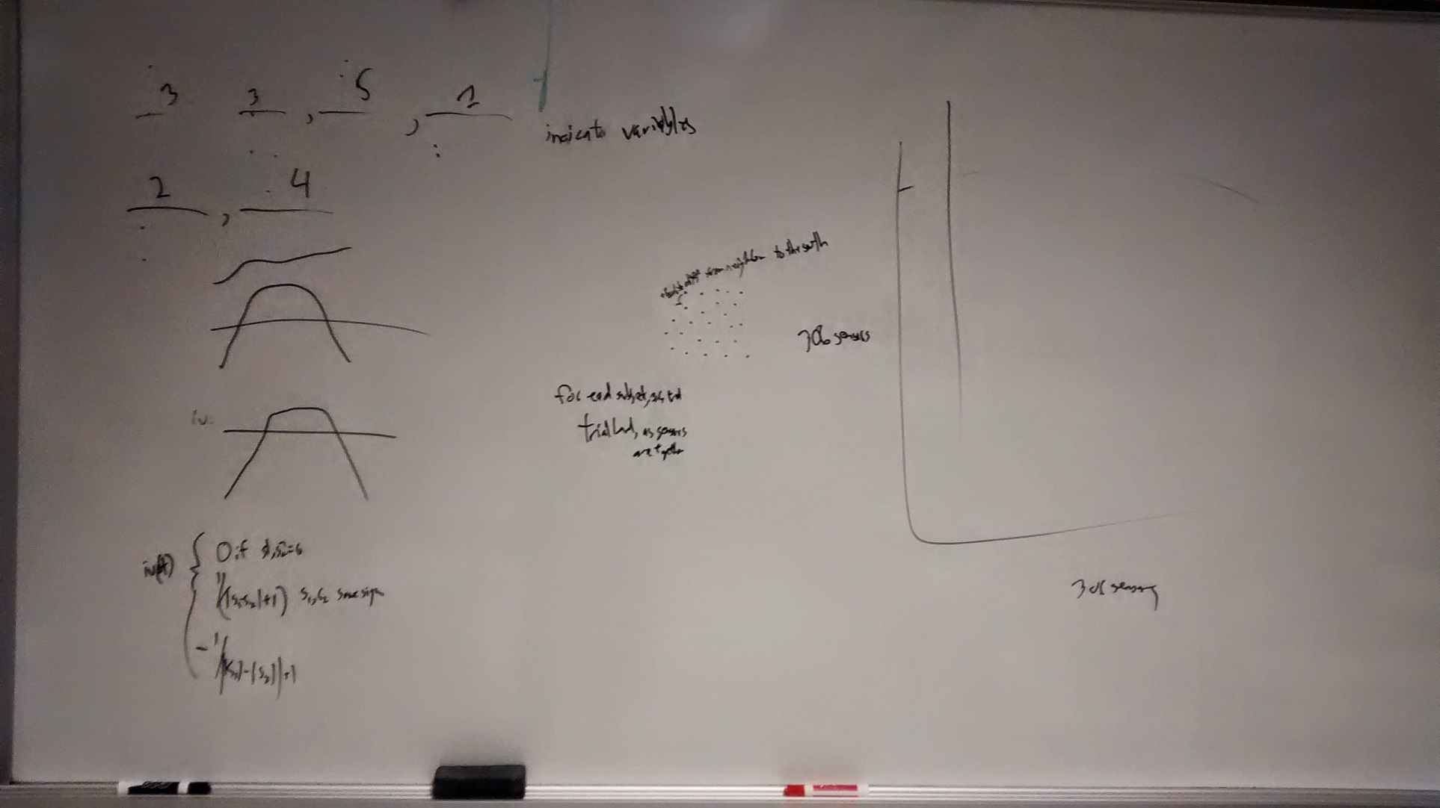

Slide 35
Step ?: More ideas
Option2: Use the labels from lasso, SVM and transductive SVM as initial seeds from which to reshuffle the classes.
Tests early on showed that, with 90% accuracy, one could successfully classify a trial with the city-block distance from the known true face/scrambled face means of a subject.

Slide 36

Step ?: Aha moment
The output from the classifiers are reasonably good approximations of the class means (70% valid).
These approximations of the means can be used to reshuffle the data labels according all trials’ distances from those 2 means.
This is classification using “the data of the subject itself”.
Additionally, use Bhattacharyya distance to measure how trustworthy a specific sensor and timepoint combination is for that subject – weight the city-block distance by the BD.

Slide 37
(Back to) Step 4: Cross-validation
Subject | Before
1 | .7441
2 | .6832
3 | .6194
4 | .7744
5 | .6803
6 | .6417
7 | .7149
8 | .6830
9 | .7559
10 | .6893
11 | .7111
12 | .7053
13 | .6888
14 | .6876
15 | .6971
16 | .5718
Mean | .6905
After Reshuffling
.7811
.7338
.6401
.8519
.7031
.6293
.7823
.8311
.7912
.6847
.7264
.7543
.7143
.7517
.7828
.6102
.7355
Subject 6 decreased in accuracy ----->
Subject 8 jumped a full 15% ----->
CV score jumped 4.5%! ----->

Slide 38
Emanuele Alexandre fchollet nagadomi Nathan 1 .71 .8485 .7727 .7962 .7811 2 .65 .7082 .7099 .7030 .7338 3 .61 .6090 .6626 .6470 .6401 4 .72 .8502 .8114 .8282 .8519 5 .69 .7235 .7406 .7150 .7031 6 .60 .6956 .6514 .6853 .6293 7 .72 .7313 .7942 .7585 .7823 8 .71 .7500 .7872 .7145 .8311 9 .73 .8148 .7694 .7693 .7912 10 .70 .7525 .7356 .7033 .6847 11 .67 .6284 .7280 .7364 .7264 12 .66 .8140 .6894 .7593 .7543 13 .66 .7313 .7075 .7125 .7143 14 .68 .7942 .7585 .7448 .7517 15 .70 .8086 .7758 .7120 .7828 16 .56 .6831 .5915 .5864 .6102
Av: .67 .746 .730 .723 .736

Slide 39
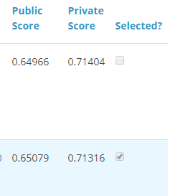
Step 7: Submit to Kaggle…
D:
Public Leaderboard

Slide 40

Step 7: Submit to Kaggle…
Trust your cross-validation results.
Know your data.
Root-mean-square distances between training subjects and all subjects – subject 18 is public leaderboard

Slide 41
Step 7: Submit to Kaggle…
:D

Slide 42
Thanks for listening

